Slide 1

News Article Topic
Classification
CISC 874
Bote Jiang
Fraser Raney

Slide 2

Outline
Problem Introduction
Goal
Data Analysis
Existing Work
Methods
Results
Future Work

Slide 3

Problem Introduction
With the decline of newspaper circulation, many news vendors turn to online distribution
Publishing news easier than ever
With thousands of posts for a single publisher each day, manually inspecting each classification is a daunting task
Difficult to find article of choice without proper classification

Slide 4
Problem Introduction (Cont.)
One solution is to use machine learning to automatically classify these texts
Text classification is a classical natural language processing (NLP) problem
Methods range from traditional statistical approaches to more advanced neural network techniques

Slide 5
Evaluate and implement a model that can classify news articles

Slide 6
Evaluate the relative performance improvement of using different pretrained embeddings for this task

Slide 7
Exploratory Data Analysis

Slide 8

Dataset
Contains headlines, URLs, and categories for 422,937 news stories in 2014
From UCI machine learning repository
News categories included in this dataset include business; science and technology; entertainment; and health.
Posted as a Kaggle competition

Slide 9
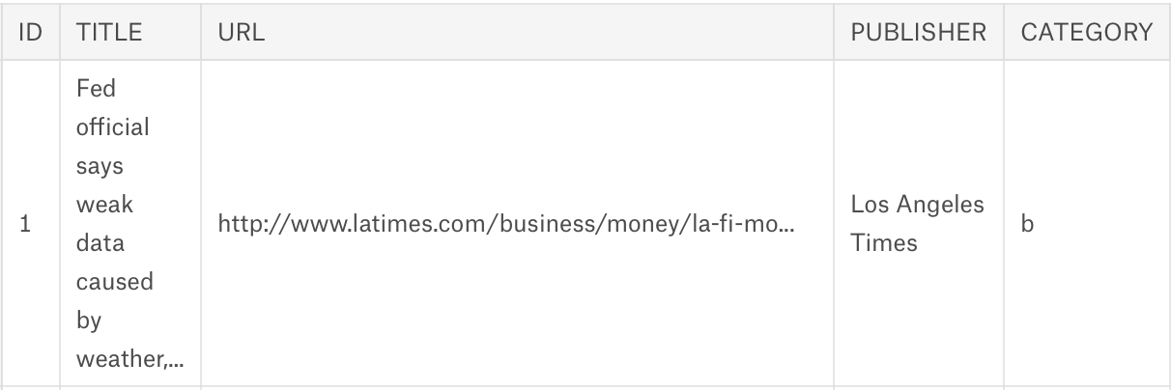
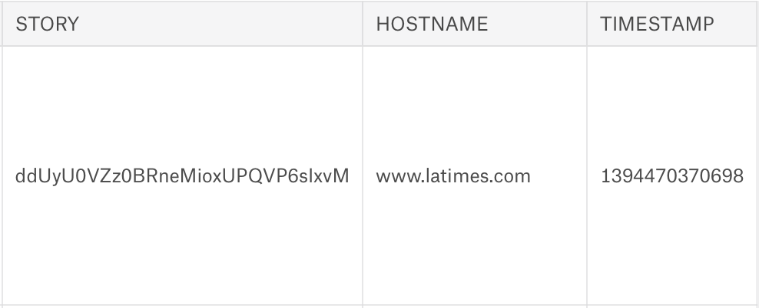
Sample Row

Slide 10
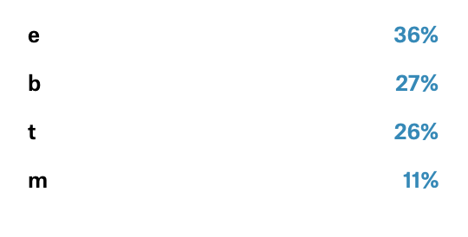
Label Distribution
We found that there was no severe class imbalance
Do not have to upsample or downsample which may lead to either overfitting or underfitting

Slide 11

Dataset
Contains full text, and categories for 2225 news stories
From the British Broadcasting Corporation (BBC)
News categories included in this dataset include business; entertainment;politics; sports; and technology

Slide 12

Sample Row

Slide 13
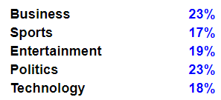
Label Distribution
There was no severe class imbalance
Do not have to upsample or downsample which may lead to either overfitting or underfitting

Slide 14
Existing Work

Slide 15
Deep Neural Networks
CNN:
Analyse same patterns on different subfields
Considers only the current input
Sigmoid nonlinear units to rectified linear units
Either 0 or 1 depending on the sign of x
LSTM (RNN):
Sequential process and can use memory to process sequences
Considers the current input and also the previously received inputs
The gating functions allow the network to decide how much the gradient vanishes, and can take on different values at each time step.

Slide 16
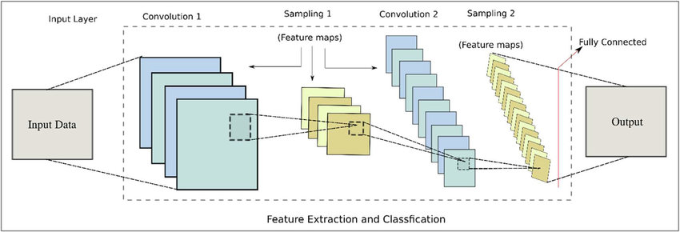
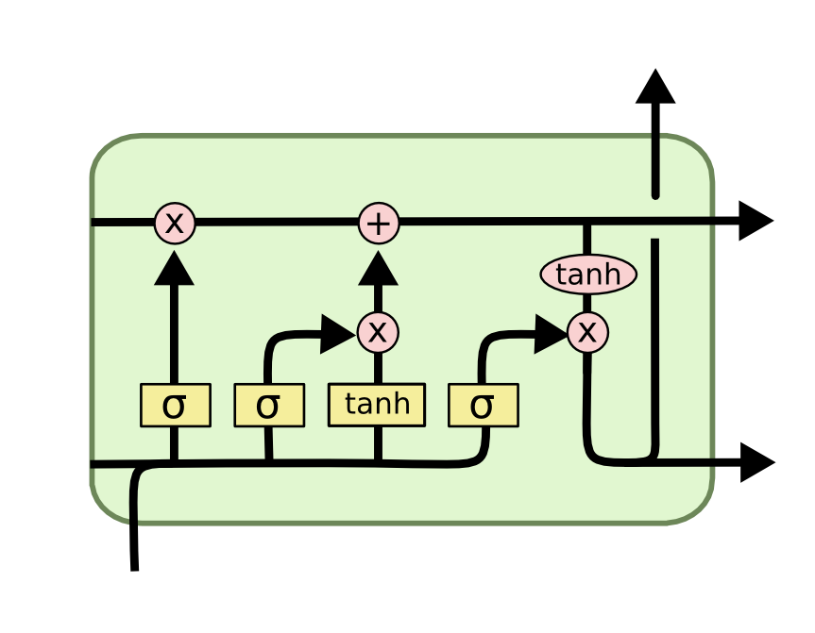
CNN’s are better when the sequence of words don’t matter as much. Due to hierarchical structure
LSTM’s are better for context detection as they have a sequential architecture (Vu et. al, 2016)

Slide 17
Other Methods
Naive Bayes (Bansal 2018):
A probabilistic inference algorithm
Considers each feature to be independent of each other
Simple but fast
Boosting (Kaggle):
Ensemble method that transforms weak learners to strong ones
Very popular for Kaggle Classification tasks
Support Vector Machines (Yu et. al 2012)
Finding decision boundaries in non-linear spaces
Often used as a baseline for text classification

Slide 18
Methods

Slide 19

Text Preprocessing
Lemmatization/Normalize
Remove stopwords
Exclude punctuation
Tokenize text
Remove unwanted columns
Split data

Slide 20

Embedding Methods
Word Embedding converts words to n-dimensional vectors
Represents relationship between words and turns text into a form that can be prefered by classifiers
CountVectorizer:
Converts a collection of text documents to a matrix of token counts
TF-IDF Transformer
Transforms count matrix to normalized vector that scales down the impact of tokens that occur very frequently

Slide 21


Embedding Methods (Cont.)
ELMo
Uses bidirectional LSTMs trained on a language modeling objective
ELMo analyses words within the context that they are used
Character based –> out of dictionary words
BERT
“Masked language modeling”
Words are randomly erased and masked. Predict for the masked word based on the unmasked words left and right of it
Word based

Slide 22
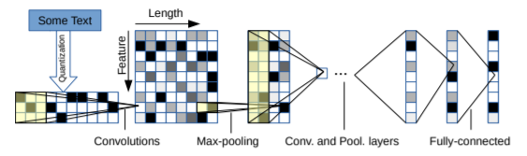
Convolutional Neural Network Design
Extract information from raw signals
A signal is a 1-D “image”
Temporal dimension
By applying multiple convolutions, “filters”, we can extract learnable features from the signal
Zhang, X., Zhao, J., & LeCun, Y. (2015). Character-level convolutional networks for text classification. In Advances in neural information processing systems (pp. 649-657).

Slide 23
Convolutional Neural Network Design
The same network model can be used for character-level text-representation and word-level for comparison
Zhang, X., Zhao, J., & LeCun, Y. (2015).
Architecture
Conv1D, 250 filters, kernel size = 3
Dense, 250 units, ReLU
Dense, 4 units, Softmax
Adam optimizer
Categorical cross entropy loss, categorical accuracy metric

Slide 24
Other Methods
Multinomial Naive Bayes
scikit-learn MultinomialNB function
Boosting: LightGBM
Gradient boosting framework that uses tree based learning algorithms
Commonly used on Kaggle competitions for its speed and accuracy
SVM
scikit-learn LinearSVC library
Linear kernel
Encoded using countVectorizer + TFIDFVectorizer

Slide 25
Results

Slide 26
CNN with BERT
Difficulty accepting masked input in Tensorflow’s Conv layers required the convolutional layer to be omitted.
Disappointing results:
Only 65% F1 accuracy after training for 3 epochs on a small subset of the UCINews data (10 000 examples, 85:15 train:val split ).
Accuracy steadily increased
Recommend that BERT is trained on a TPU (Tensor processor)

Slide 27
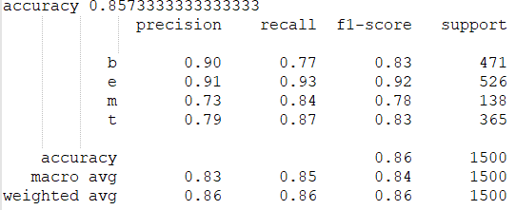
CNN with ELMo
Better results, still trained on a subset of the UCINews data
10 000 examples, 85:15 train:validation split
Trained for 10 epochs
Limiting constraint: memory

Slide 28
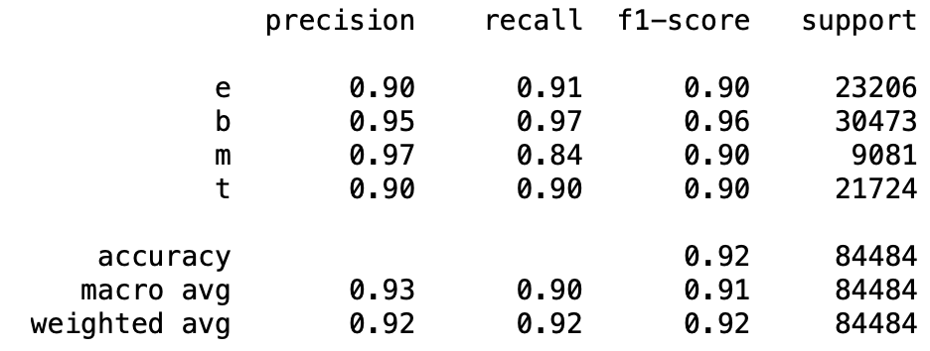
Multinomial Naive Bayes - UCINews data

Slide 29
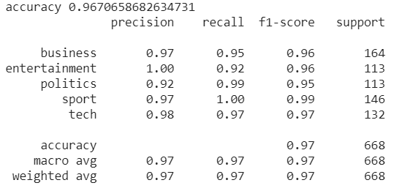
Multinomial Naive Bayes - BBCNews data

Slide 30
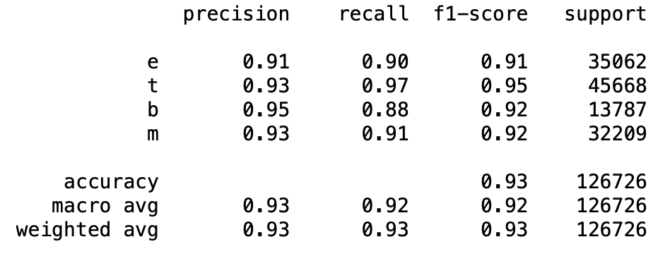
LightGBM - UCINews data

Slide 31
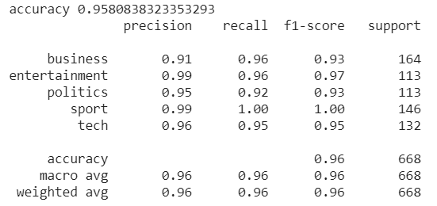
LightGBM - BBCNews data

Slide 32
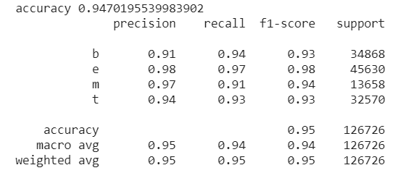
SVM (Linear Kernel) - UCINews data

Slide 33
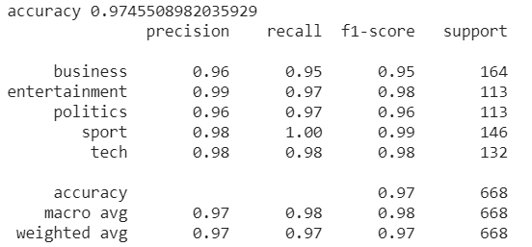
SVM (Linear Kernel) - BBCNews data

Slide 34
Future Work

Slide 35
Future Work
See if results hold true on the Insight BBCSports news dataset
Full text instead of titles
Similar categories (all sports)
Tuning hyper-parameters of models
Different Deep Neural Network architecture
Try traditional text encoding methods with CNN and LSTM

Slide 36
Conclusions
It is possible to classify only based on titles
Classifying topics for short texts is a relatively context-free task
Deep neural networks with more advanced embedding may not be suited for these tasks
Traditional methods perform better

